Slide 1
Big Mountain Resort Ski Data Analysis

Slide 2
Agenda
Problem Identification
Recommendation and Key Findings
Modeling Results and Analysis
Summary and Conclusion

Slide 3
Problem Identification: Context
Big Mountain Resort (BMR) has added an additional chair lift that increases operating cost of $1.54 million this season.
Current strategy is to charge a premium above average price. Currently, we base our pricing on market average.
There is suspicion that BMR is not capitalizing on its facilities. BMR has no sense of what facilities matter most to visitors.

Slide 4
Problem Identification: Goals
To determine what Big Mountain facilities to capitalize on to justify increased pricing, cutting costs or additional premium pricing comparative to average market prices.
What is the threshold price for weekday and weekend ticket sales to account for increased operating of $1.54 million this season?
This project aims to use a predictive model for ticket price based on a number of facilities/feature

Slide 5
Recommendation and Key Findings
Found and determined a price increase of $1.58 from $81 to $82.58 is justifiable from adding vertical drop and additional chair features.
Would have a revenue of $2,757,576 that would cover operating cost of 1.54 million this season.
Based on Random Forest Regressor, predicted model price of $102.18 with a mean absolute error of $10.24. Suggesting room for increase in price.
Important to note that ticket price is not determined by any set of parameters but also consider that people pay more or less for certain features in this current market.

Slide 6
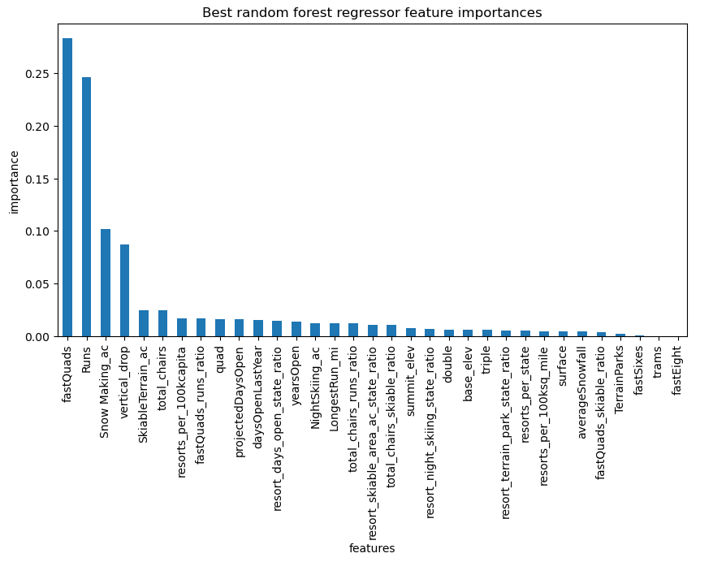
Modeling Results and Analysis
A linear model and a random forest regressor model was performed
Performance for both linear regression model and random forest regressor model were compared by cross validation for their mean absolute error with values of $11.79 and $9.48 respectively.
Thus, random forest regressor was chosen as the best optimal model to gain insights for its lower mean absolute error pertaining price and demonstration of less variability.

Slide 7
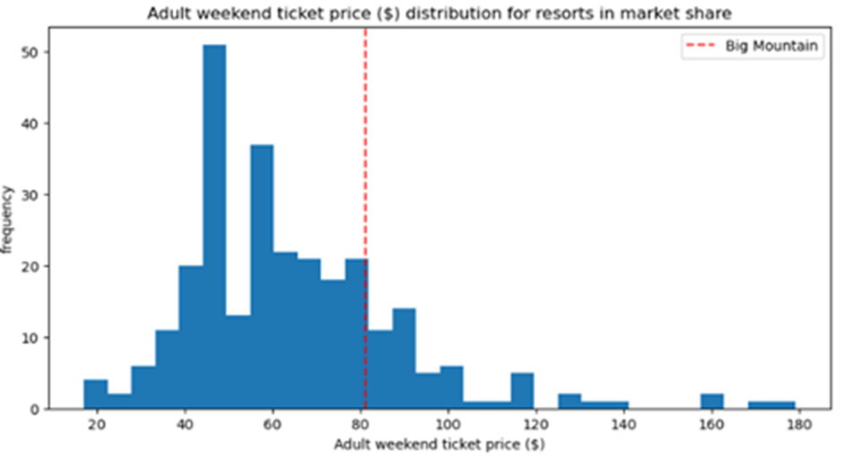
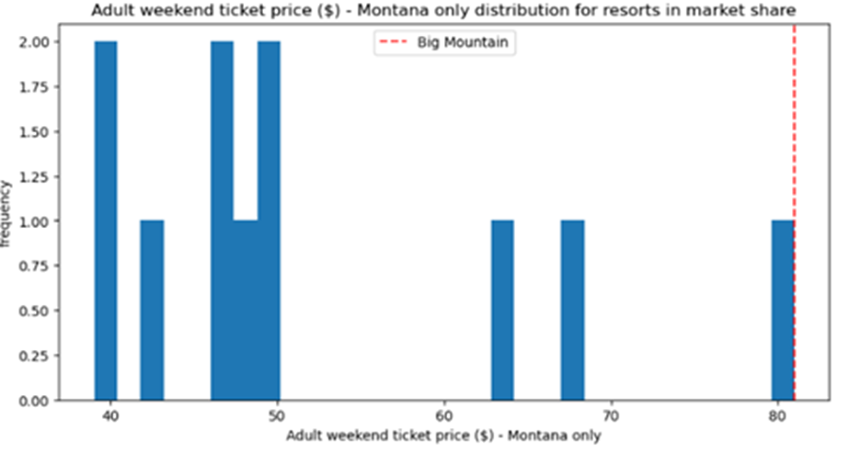
Modeling Results: Market Context

Slide 8
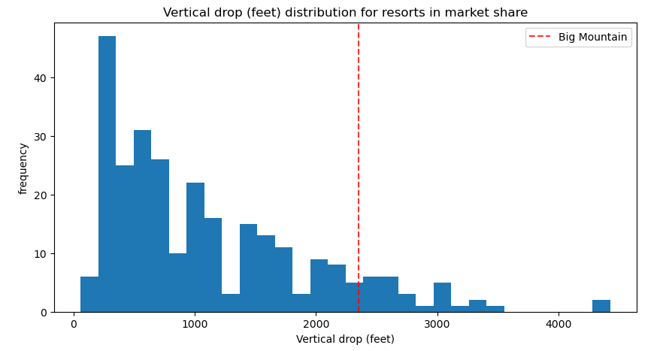
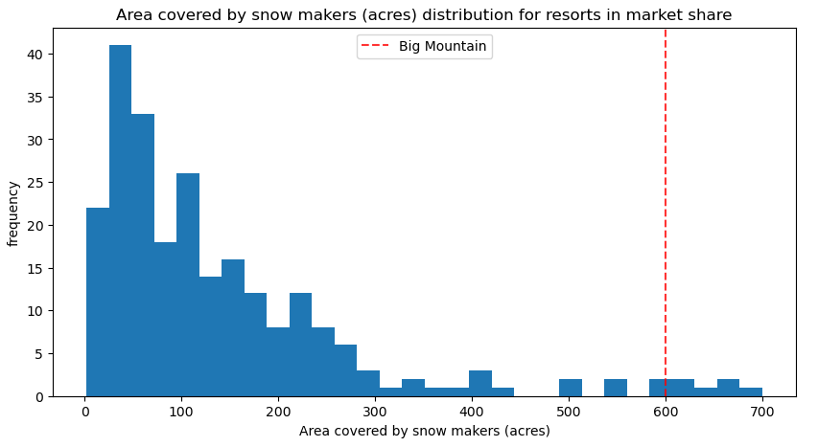
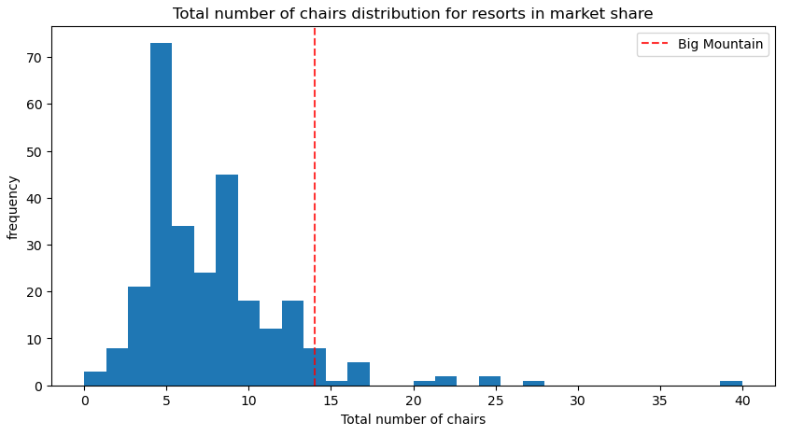
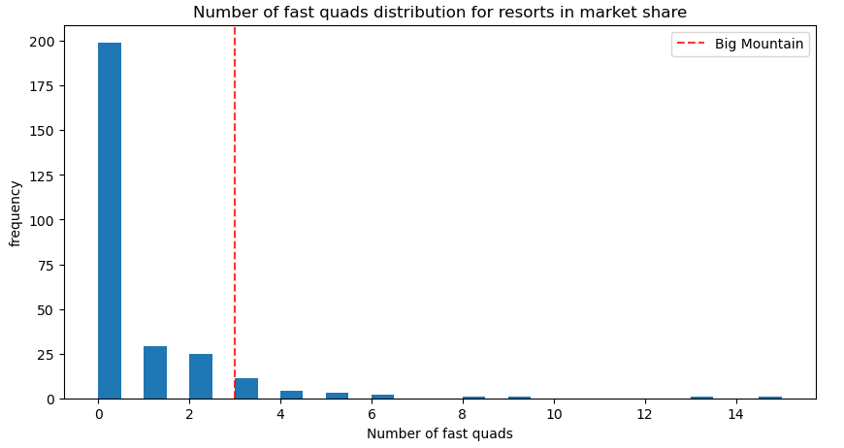
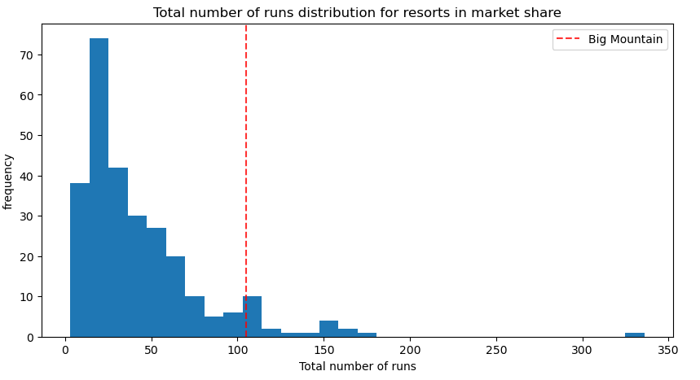
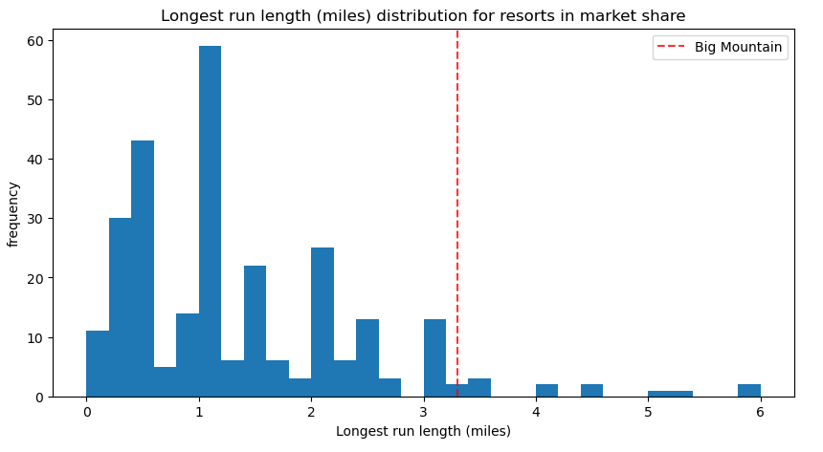
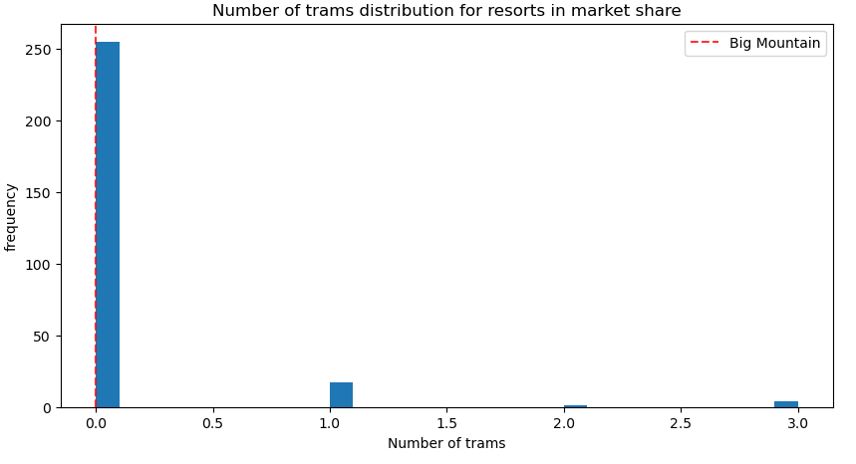
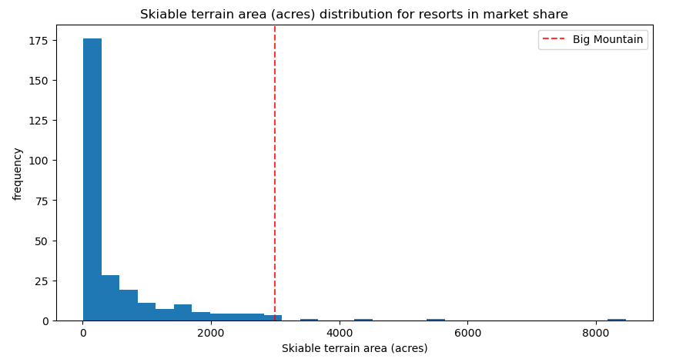

Slide 9
Modeling Results: Scenarios
Scenario 1: Permanently closing up to 10 of least used runs. This doesn't impact any other resort statistics.
Scenario 2: Increase the vertical drop by adding a run 150 feet lower down but requiring the installation of an additional chair lift to bring skiers back up, without additional snow making coverage.
Scenario 3: Same as number 2, but adding 2 acres of snow making cover.
Scenario 4: Increase the longest run by 0.2 mile to boast 3.5 miles length, requiring an additional snow making coverage of 4 acres

Slide 10
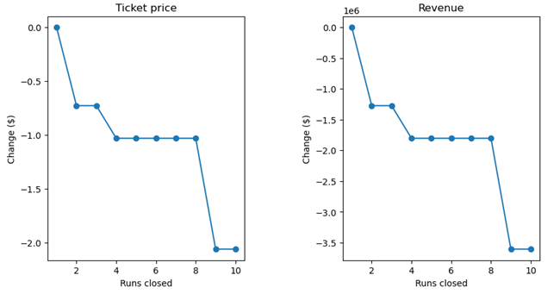
Analysis
Scenario 1: if we close 1 run, we will not see a difference in pricing/revenue. Closing 2 and 3 results in lower ticket pricing and revenue drops as a result. Closing 4 and 5 runs makes no difference, but if we close 6 or more runs, we see a steep drop in ticket pricing and revenue
Scenario 2: From model prediction, parameters support a ticket price increase by $1.58 where a revenue increase of $2,757,576 could be seen.
Scenario 3: Adds an additional Snow Making component to Scenario 2, but it makes no difference and yields the same result as Scenario 2.
Scenario 4: Calls to increase the longest run by 0.2 miles and add 4 acres of Snow Making but also made no difference whatsoever.

Slide 11
Summary and Conclusion
Capitalizing in adding a 150 ft vertical drop and adding a chair lift are features that can justify a price increase of $ 1.58 from $81 to $82.58,
This price increase would result in a predicted revenue of $2,757,576 that would account for the $1.54 million operating cost from the additional chair lift.

